Slide 1
The simplex algorithm
单纯形

Slide 2
General description
let v be any vertex顶点 of the feasible region,
while there is a neighbor v’ of v with better objective value:
set v = v’
Say there are n variables, x₁,...,x_{n}.
Any setting of the x_{i}’s can be represented by an n-tuple of real numbers and plotted in n-dimensional space.

Slide 3
General description (cont.)
A linear equation involving the x_{i}’s defies a hyperplane in this same space R_{n},
and the corresponding linear inequality线性不等式 defines a half-space半空间, all points that are either precisely on the hyperplane or lie on one particular side of it.
Finally, the feasible region of the linear program is specified
by a set of inequalities and is therefore the intersection of
the corresponding half-spaces, a convex polyhedron.多变体

Slide 4
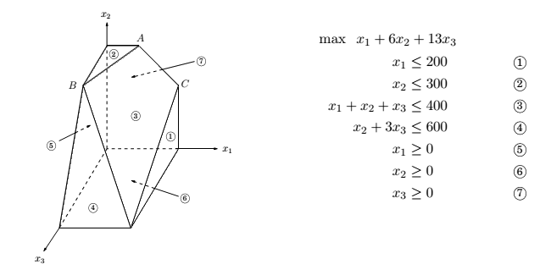
A polyhedron defined by seven inequalities

Slide 5
Vertices and neighbors in n-dimensional space
Definition
Each vertex is the unique point at which some subset of hyperplanes meet.
Pick a subset子集 of the inequalities. If there is a unique point that satisfies them with equality, and this point happens to be feasible, then it is a vertex.
Each vertex is specified by a set of n inequalities.
Definition
Two vertices are neighbors if they have n − 1 defining inequalities in common.

Slide 6
The algorithm
On each iteration, simplex has two tasks:
1. Check whether the current vertex is optimal (and if so, halt);
2. Determine where to move next.
As we will see, both tasks are easy if the vertex happens to be at the origin原点. And if the vertex is elsewhere, we will transform the coordinate system(坐标变换) to move it to the origin!

Slide 7

The convenience for the origin
Suppose we have some generic LP:
where x is the vector of variables, x = (x₁,...,x_{n}).
Suppose the origin is feasible. Then it is certainly a vertex, since it is the unique point at which the n inequalities
x₁ ≥ 0,...,x_{n} ≥ 0
are tight.

Slide 8
Task 1 in the origin
Lemma显而易见
The origin is optimal if and only if all c_{i} ≤ 0. (We need b > 0)
Proof.
If all c_{i} ≤ 0, then considering the constraints x ≥ 0, we can’t hope for a better objective value.
Conversely, if some c_{i} > 0, then the origin is not optimal, since we can increase the objective function by increasing some x_{i}.

Slide 9
Task 2 in the origin原点不是最优解
We can move by increasing some x_{i} for which c_{i} > 0.
How much can we increase it?
Until we hit some other constraint. That is, we release the tight constraint x_{i} ≥ 0 and increase x_{i} until some other inequality, previously loose, now becomes tight.
At that point, we again have exactly n tight inequalities, so we are at a new vertex u.

Slide 10
What if our current vertex u is elsewhere?
The trick is to transform u into the origin, by shifting the coordinate system from the usual (x₁,...,x_{n}) to the “local view” from u.
These local coordinates consist of (appropriately scaled) distances y₁,...,y_{n} to the n hyperplanes (inequalities) that define and enclose u.
Specifically, if one of these enclosing inequalities is a_{i} ·x ≤ b_{i},
then the distance from a point x to that particular “wall” is
y_{i} = b_{i}− a_{i}· x.
The n equations of this type, one per wall, define the y_{i}’s as linear functions of the x_{i}’s, and this relationship can be inverted to express the x_{i}’s as a linear function of the y_{i}’s.

Slide 11

Rewriting the LP
Thus we can rewrite the entire LP in terms of the y’s.
This doesn’t fundamentally change it (for instance, the optimal value stays the same), but expresses it in a different coordinate frame.
The revised “local” LP has the following three properties:
1. It includes the inequalities y ≥ 0, which are simply
the transformed versions of the inequalities deﬁning u.
2. u itself is the origin in y-space.
3. The cost function becomes max , where c_{u} is the value of the objective function at u and is a transformed cost vector.

Slide 12
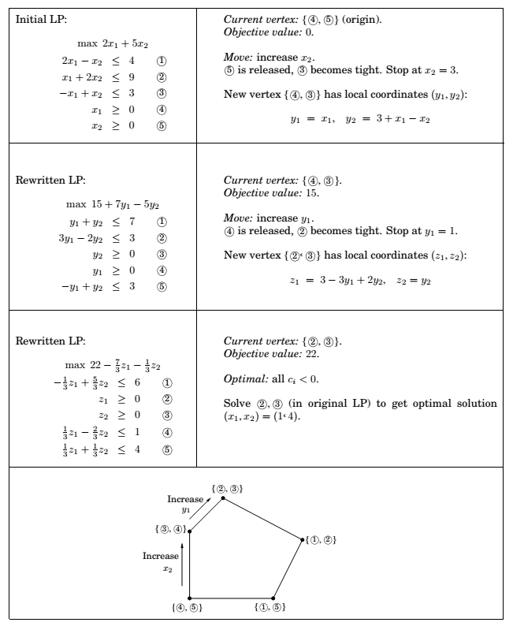

Slide 13
The starting vertex
In a general LP, the origin might not be feasible and thus not a vertex at all.
However, it turns out that finding a starting vertex can be reduced to an LP and solved by simplex!
Start with any linear program in standard form:
min c^{T}x such that Ax = b and x ≥ 0.

Slide 14
The starting vertex (cont.)
We first make sure that the right-hand sides of the equations are all nonnegative: if b_{i} < 0, just multiply both sides of the ith equation by -1.
Then we create a new LP as follows:
Create m new artiﬁcial variables z₁,...,z_{m} ≥ 0, where m is the number of equations.
Add z_{i} to the left-hand side of the ith equation.
Let the objective, to be minimized, be z₁ + z₂ + ··· + z_{m}.

Slide 15
The starting vertex (cont’d)
For this new LP, it’s easy to come up with a starting vertex, namely, the one with z_{i} = b_{i} for all i and all other variables zero.
Therefore we can solve it by simplex, to obtain the optimum solution. There are two cases:
If the optimum value of z₁ + z₂ + ··· + z_{m} is zero, then all z_{i}’s obtained by simplex are zero, and hence from the optimum vertex of the new LP we get a starting feasible vertex of the original LP, just by ignoring the z_{i}’s.
If the optimum objective turns out to be positive: We tried to minimize the sum of the z_{i}’s, but simplex decided that it cannot be zero. But this means that the original linear program is infeasible不可行: it needs some nonzero z_{i}’s to become feasible.

Slide 16
Degeneracy
A vertex is degenerate if it is the intersection相交 of more than n faces of the polyhedron, say n+1.
Algebraically, it means that if we choose any one of n sets of n+1 inequalities and solve the corresponding system of n linear equations in n unknowns, we’ll get the same solution in all n+1 cases.
This is a serious problem: simplex may return a suboptimal degenerate vertex simply because all its neighbors are identical to it and thus have no better objective.
And if we modify simplex so that it detects degeneracy and continues to hop from vertex to vertex despite lack of any improvement in the cost, it may end up looping forever.

Slide 17
Degeneracy (cont’d)
One way to fix this is by a perturbation:
change each b_{i} by a tiny random amount to b_{i} ± ε_{i}.
This doesn’t change the essence of the LP since the ε_{i}’s are tiny, but it has the effect of differentiating between the solutions of the linear systems.

Slide 18
Unboundedness无界
In some cases an LP is unbounded, in that its objective function can be made arbitrarily large (or small, if it’s a minimization problem).
If this is the case, simplex will discover it: in exploring the neighborhood of a vertex, it will notice that taking out an inequality and adding another leads to an underdetermined system of equations that has an infinity of solutions.
And in fact (this is an easy test) the space of solutions contains a whole line across which the objective can become larger and larger, all the way to ∞.
In this case simplex halts and complains.要及时终止

Slide 19
The running time of simplex
What is the running time of simplex, for a generic linear program:
max c^{T}x such that Ax ≤ 0 and x ≥ 0.
where there are n variables and A contains m inequality constraints?
It is an iterative algorithm that proceeds from vertex to vertex.
Let u be the current vertex, i.e., unique point at which n inequality constraints are satisfied with equality. Each of its neighbors shares n−1 of these inequalities, so u can have at most n · m neighbors(一般都没有这么多)：choose which inequality to drop and which new one to add.只有一个有效约束不同的点就是邻点

Slide 20
The running time of simplex (cont.)
A naive way for an iteration: (1) check each potential neighbor to see whether it really is a vertex of the polyhedron；邻点是否可行 (2) determine its cost. 邻点目标函数的值
(2) is easy. (1) involves: solve a system of n equations and check whether the result is feasible.
By Gaussian elimination this takes O(n³) time, giving total O(mn⁴) per iteration.

Slide 21
The running time of simplex (cont’d)
A much better way: the mn⁴ can be improved to mn.
Recall the local view from vertex u. The per-iteration overhead of rewriting the LP in terms of the current local coordinates is just O((m +n)n); since the local view changes only slightly between iterations, in just one of its defining inequalities.
Next, to select the best neighbor, we recall that the (local view of) the objective function is of the form
where c_{u} is the value of the objective function at u.

Slide 22
The running time of simplex (cont’d)
This immediately identifies a promising direction to move: we pick any (if there is none, then the current vertex is optimal and simplex halts).
Since the rest of the LP has now been rewritten in terms of the y-coordinates, it is easy to determine how much y_{i} can be increased before some other inequality is violated. (And if we can increase y_{i} indefinitely, we know the LP is unbounded.)如果yi是无限增加或减少，则是无界的，可以终止了

Slide 23
The running time of simplex (cont’d)
How many iterations could there be?
At most
i.e., the number of vertices.
It is exponential in n. And in fact, there are examples of LPs for which simplex does indeed take an exponential number of iterations.
Simplex is an exponential-time algorithm.
However, such exponential examples do not occur in practice, and it is this fact that makes simplex so valuable and so widely used.

Slide 24
Postscript: circuit evaluation

Slide 25
An ultimate application
We are given a Boolean circuit, that is, a dag of gates of the following types.
Input gates have indegree zero, with value true or false.
AND gates and OR gates have indegree 2.
NOT gates have indegree 1.
In addition, one of the gates is designated as the output.
The CIRCUIT VALUE problem is the following: when the laws of Boolean logic are applied to the gates in topological order, does the output evaluate to true?

Slide 26
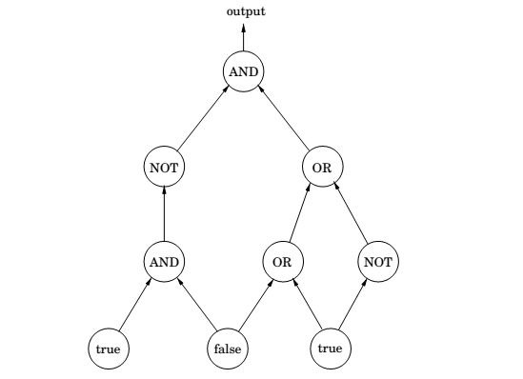
Circuit evaluation

Slide 27
LP formulation
Create a variable x_{g} for each gate g, with constraints 0 ≤ x_{g} ≤ 1.
Add additional constraints for each type of gate:
true gate: x_{g} = 1.
false gate: x_{g} = 0.
OR gate with inputs h and h’ : x_{g} ≥ x_{h} , x_{g} ≥ x_{h’} , x_{g} ≤ x_{h} + x_{h’} .
AND gate with inputs h and h’ : x_{g} ≤ x_{h} , x_{g} ≤ x_{h’} , x_{g} ≥ x_{h} + x_{h’} − 1.
NOT gate with input h: x_{g} = 1 − x_{h}.
These constraints force all the gates to take on exactly the right values – 0 for false, and 1 for true. We don’t need to maximize or minimize anything, and we can read the answer off from the variable x_{o} corresponding to the output gate.

Slide 28
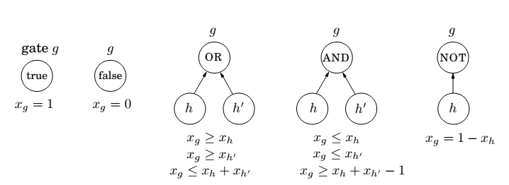
Circuit evaluation

Slide 29
The generality
The CIRCUIT VALUE problem is in a sense the most general problem solvable in polynomial time!
After all, any algorithm will eventually run on a computer, and the computer is ultimately a Boolean combinational circuit implemented on a chip.
If the algorithm runs in polynomial time, it can be rendered as a Boolean circuit consisting of polynomially many copies of the computer’s circuit, one per unit of time, with the values of the gates in one layer used to compute the values for the next.
Hence, the fact that CIRCUIT VALUE reduces to linear programming means that all problems that can be solved in polynomial time do!每个电路的值可以归约到线性规划

